Slide 1



Netflix Shows and Movies Data Cleaning
View in Power BI
Last data refresh:
12/20/2024 11:56:51 PM UTC
Downloaded at:
12/20/2024 11:57:57 PM UTC

Slide 2
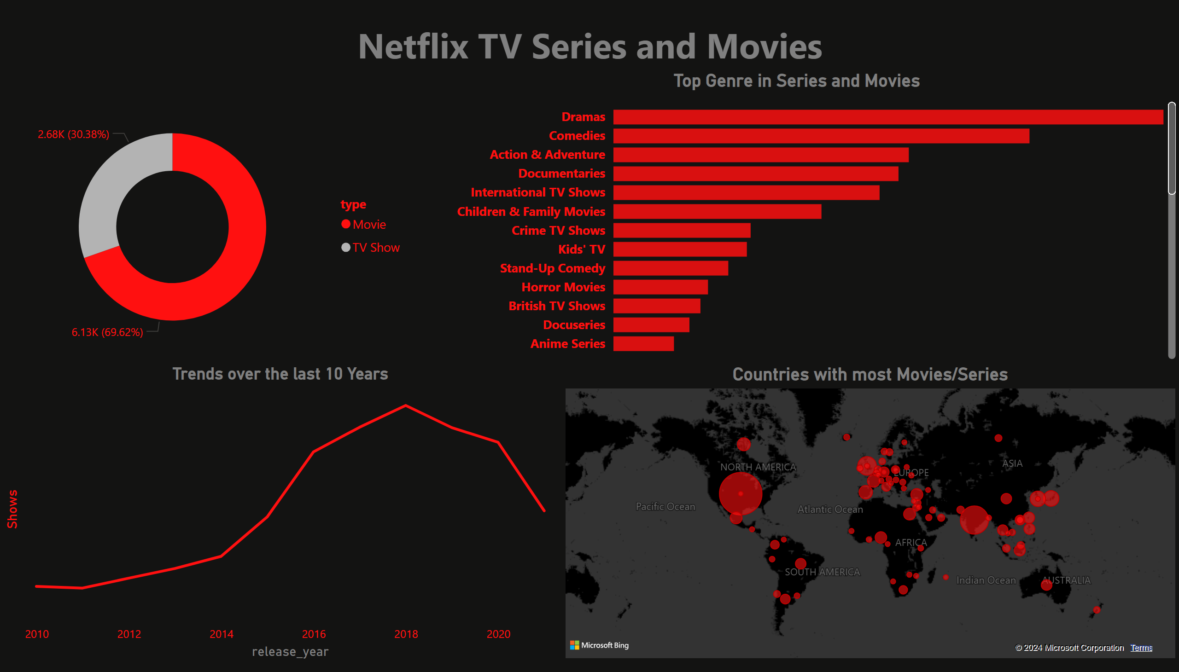
Page 1
Notes:
Ratio of Series and Movies
No alt text provided
Trends over the last 10 Years
No alt text provided
textbox
No alt text provided
Top Genre in Series and Movies
No alt text provided
Countries with most Movies/Series
No alt text provided

